Slide 1

EFFICIENT CAUSAL GRAPH DISCOVERY USING LARGE LANGUAGE MODELS Thomas Jiralerspong, Xiaoyin Chen, Yash More, Vedant Shah, Yoshua Bengio

Slide 2
Causal Inference vs Causal Discovery
Causal Inference
Assumes a known causal graph (DAG)
Goal: Estimate the effect of interventions (e.g., do(X) on Y)
Often uses tools like do-calculus, structural causal models (SCMs), and counterfactuals
Example: What is the effect of a new drug on patient recovery?
Causal Discovery
Causal graph is unknown
Goal: Learn the structure of the causal graph from data or domain knowledge
Relies on statistical patterns (e.g., conditional independencies) or expert knowledge
Example: Which symptoms are caused by a particular nerve injury?

Slide 3
Introduction
Recent advances in large language models (LLMs) have significantly improved AI capabilities.
LLMs can use their knowledge to generate plausible explanations given observations and even reason on counterfactuals.
Can LLMs reason about causal relationships?
Causal discovery involves identifying the causal relationships between different variables.
This process usually results in a Directed Acyclic Graph (DAG), with edges representing the existence and direction of causal influences.
This causal graph represents the relationships between variables which govern the data generation process.

Slide 4
Can LLMs reason causally?
Recent works have shown that LLMs are capable of leveraging their internal knowledge to perform common sense.
This work utilizes LLMs to respond to causal queries solely based on metadata, such as variable names and descriptions, without accessing the numerical observations.
One straightforward approach which previous works use is to perform pairwise queries over all possible pairs of variables => O(C(n, 2)) = O(n^2)
The experiments in these works are limited to very small causal graphs.

Slide 5
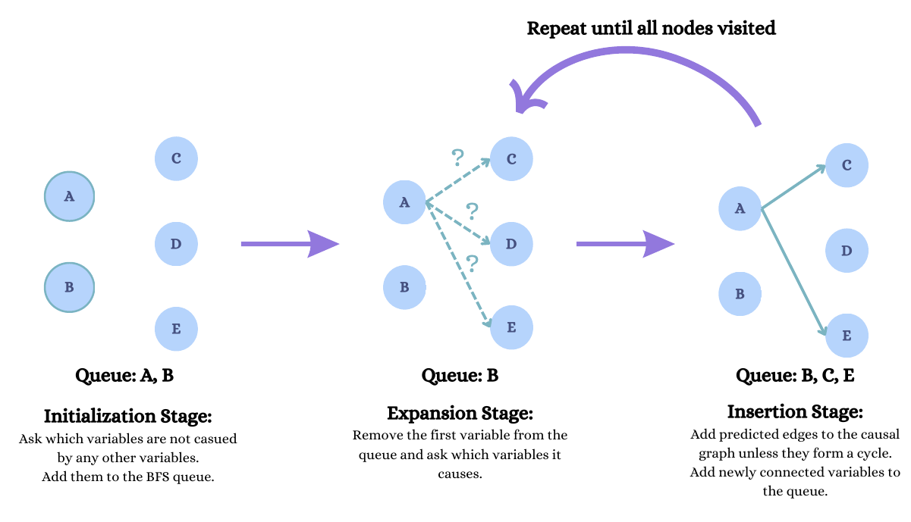
CD with LLMs in Linear Time

Slide 6
Graph Traversal Algorithms: BFS vs DFS
BFS:
BFS Explores nodes level by level.
Suitable for layered exploration. e.g., discovering immediate effects of root causes before deeper levels.
DFS:
Explores paths as deep as possible before backtracking.
Useful for cycle detection

Slide 7
CD with LLM using BFS ordering queries
Three Stage algorithm:
Initialization Stage: The LLM is prompted to identify variables that are not causally affected by any other variables in the graph
Expansion Stage: The LLM is instructed to find variables caused by the current node
Insertion Stage: The variables proposed by the LLM are added to the BFS queue and the edges proposed by the LLM are checked to make sure they do not cause cycles before being inserted.

Slide 8
Initialization Stage Example (on the Neuropathic Pain Dataset)
You are a helpful assistant to a neuropathic pain diagnosis expert. The following factors are key variables related to neuropathic pain diagnosis which have various causal effects on each other. Our goal is to construct a causal graph between these variables.
<A>: Description of variable A
<B>: Description of variable B
…
Now you are going to use the data to construct a causal graph. You will start with identifying the variable(s) that are unaffected by any other variables. Think step by step. Then, provide your final answer (variable names only) within the tags <Answer>...</Answer>.

Slide 9
Expansion Stage Example (on the Neuropathic Pain Dataset)
Given <Independent Variables> is(are) not affected by any other variable and the following causal relationships:
A causes B, C, D
C causes D, E
...
Select the variables that are caused by <Currently Visited Node>. Think step by step. Then, provide your final answer (variable names only) within the tags <Answer>...</Answer>.

Slide 10
Insertion Stage Example
For each variable predicted by the LLM
Add it to the queue of nodes to be visited
Perform a cycle check before adding this edge to the predicted causal graph
Alternate between the expansion and insertion stages until all nodes have been visited
The number of queries required for the proposed algorithm is O(n), as BFS only visits each node once.

Slide 11
Experiment and Result
Used the GPT-4 API
Three datasets:
Asia: a small causal graph that models lung cancer in patients having potentially recently visited Asia. The ground-truth graph has 8 nodes and 8 edges
Child: The Child causal graph is a medium-sized causal graph which models congenital heart disease in newborn babies. The ground-truth graph has 20 nodes and 25 edges.
Neuropathic Pain: The Neuropathic Pain causal graph is a very large causal graph consisting of 221 nodes and 770 edges. It contains relationships between different nerves and the associated symptoms that patients express.

Slide 12
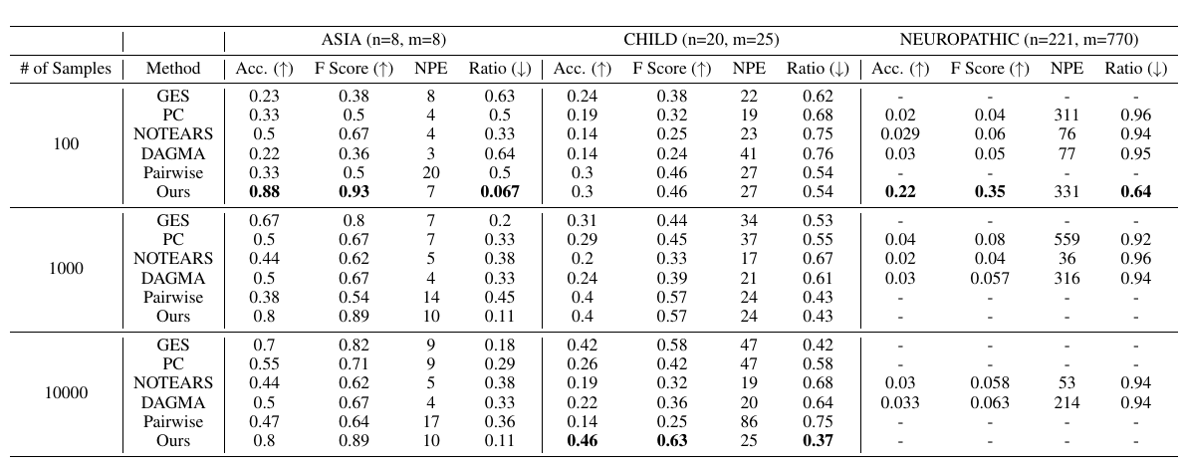
Experiment and Result (Cont’d)

